Slide 1
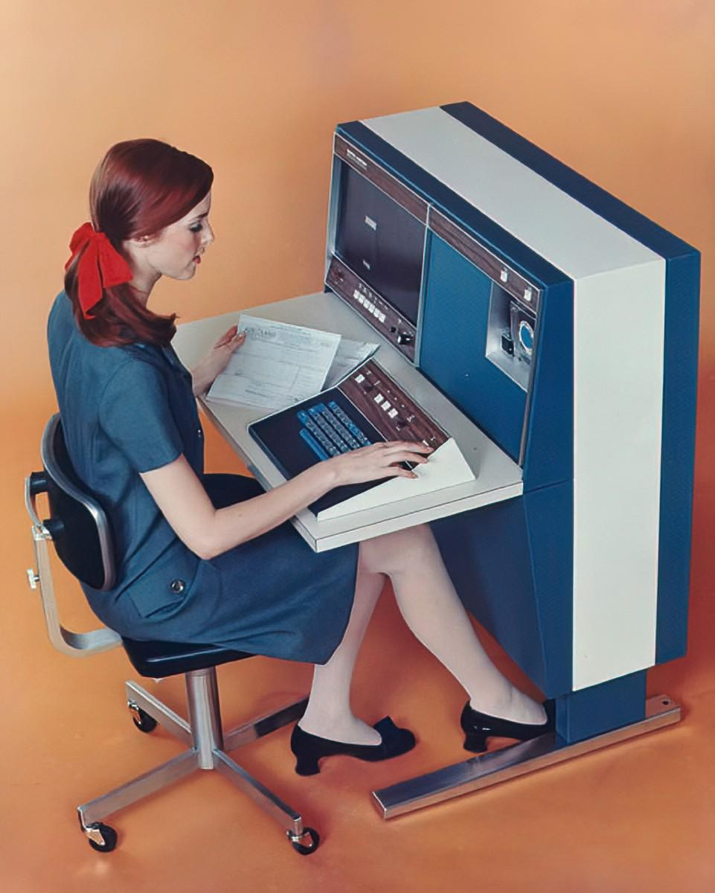
W E L C O M E
hy-tech club:
WEB 101
Notes:
Note: Italicized text is meant as commentary/instruction. Unitalicized text is meant to be spoken directly.
Activity Preparation
Play some music in the background, like this: https://www.youtube.com/watch?v=MVPTGNGiI-4
Welcome the students as they arrive
Once everyone is seated, cut the music
Introduce yourselves and provide a little background
Move to the next slide

Slide 2
Agenda
Overview
Icebreaker
Presentation
Glitch Setup
Code-Along
Blooket
Notes:
Here’s what we’ll be doing tonight!

Slide 3
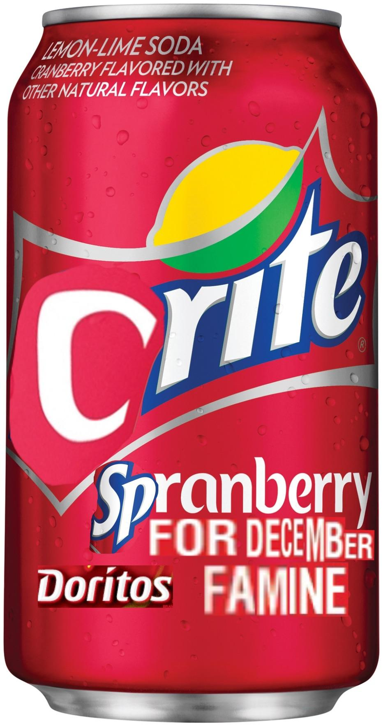



Course Overview
In this course, you will learn how to build websites with HTML & CSS!
By the end, you will have a totally original website of your own design, about any topic your heart desires.
Notes:
What are we doing here?
In this course, you will learn how to build websites with HTML and CSS.
By the end, you will have your own website, and it can be about anything at all! It could be about…
A sports team,
A beverage,
Video game movie rankings,
A music artist,
Or really anything at all. Start thinking about what you might want to make for your website, and your instructors will help you learn all you need to know to end the semester with a finished product. How will we do this, you may ask…

Slide 4
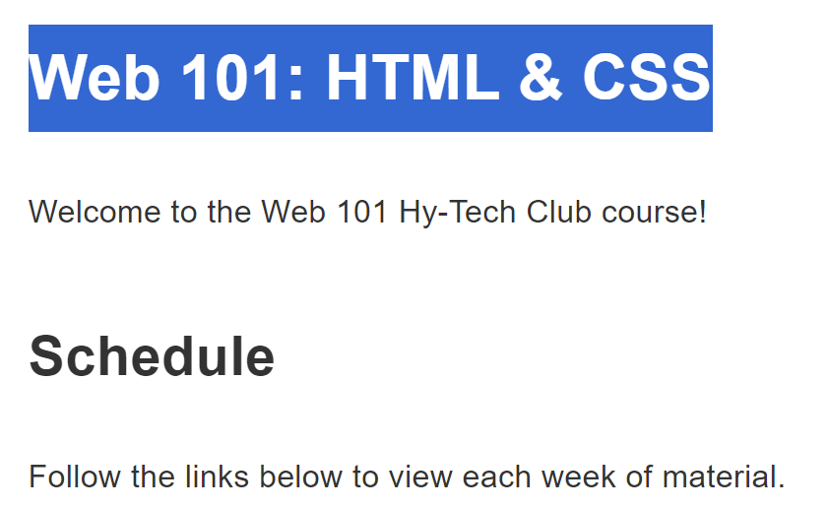
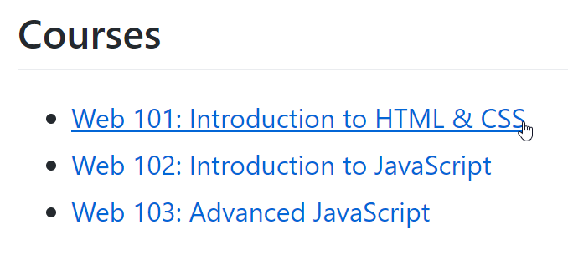
hylandtechclub.com
Your one-stop-shop for all Hy-Tech Club material!
Notes:
You will definitely want to remember hyland tech club dot com. This is your one stop shop for everything.
When you open it up, you should be able to find the link to Web 101 -
Click that, and you’ll go to the Web 101 course website. This is where everything for this course lives. If you ever don’t know what to do, go there. PLEASE BOOKMARK THIS SITE

Slide 5
Tech Outreach Team Goals for Web 101
These goals guide the direction of the club and this course:
100% of students submit final projects
That means every one of you!
At least 75% of students return for Web 102
Hopefully almost all of you, if not all of you!
Student-driven, not curriculum driven
Joy-driven, not expectation-driven
Present-driven, not future-driven
TENETS
Notes:
As your instructors lead you through the material, there are a few goals we will have. We’re sharing these so we can all be on the same page about a successful outcome for this course.
We hope that 100% of you submit final projects. That’s every single one!
We also hope that at least 75% of you come back for Web 102. Not necessarily everybody, but basically as many as possible. We really want you to have a good experience – good enough that you want to return.
We are also guided by three tenets – we want this course to be driven more by you than by the curriculum. If you have a better idea for a website, or a different application for a topic, or want to do your own thing – please let us know. We also want to focus a lot more on joy than education. Obviously, we want you to learn – but mostly, we want you to have fun. Please let us know if you’re bored, and if we can make your experience better. And finally, we want to focus on the present. We’re going to talk more about the future, but while you’re here, don’t worry about any of that. Just try to have fun with what you’re doing!

Slide 6
Instructor Expectations
Provide a delightful, memorable, impactful experience
Create a supportive, inclusive classroom environment
Teach with honesty and integrity
Student Expectations
By the end of the semester, build a website that is meaningful to you
Communicate your feelings with instructors
Respect your instructors and fellow students
Notes:
To that end, we have some expectations set up for both students AND instructors.
Instructors should: provide a delightful, memorable, impactful experience by creating a supportive, inclusive classroom environment while teaching with honesty and integrity.
Students should: build a website that means something to you, communicate your feelings, and treat everyone with respect. Whyever you’re here, we want you to make the most of it.

Slide 7
The Journey
Future endeavors
High School Internship
You are here
Web 103
Web 101
Hyland Hackathon
Web 102
Previous experience
Notes:
Many of you are here for many different reasons, but we’re in the same place.
Right now, we are in Web 101. There’s no right or wrong path, but you’re all here on a journey. This might be the very beginning, or you might be well on your way. This might be the end. You may bring a lot of previous experience, or none. This might lead you directly to Web 102 and then Web 103, or you might go on to do your own thing, or you might never look at a computer again, or maybe you’ll end up participating in the hackathon or joining us as a high school intern. All of that is great and wonderful – we want to give you the best possible experience while you’re here! But for a little inspiration, let’s take a look at what lies ahead.

Slide 8
The Journey
Future endeavors
High School Internship
By the end of Web 101…
https://hylandtechclub.com/showcase/Web101/Brooke/index.html
https://hylandtechclub.com/showcase/Web101/Aidan/index.html
https://hylandtechclub.com/showcase/Web101/Cool/index.html
Web 103
Web 101
Hyland Hackathon
Web 102
Previous experience
Notes:
By the end of this course, you should be able to make a pretty full-featured website, about whatever topic you desire. Here are some examples – one of them is about video game film adaptations. One of them is about selling fake products (not recommended). One of them is just really cool.
Our goal is to give you the skills you need to make something like any of these sites. That should all be possible by the end of this semester! But looking even farther ahead…

Slide 9
The Journey
Future endeavors
High School Internship
Web 103
Through Web 102 and Web 103…
https://hylandtechclub.com/showcase/Web103/GetCat/index.html
https://hylandtechclub.com/showcase/Web102/SpunchBopOS/index.html
Web 101
Hyland Hackathon
Web 102
Previous experience
Notes:
If you decide to continue with Hy-Tech Club, you’ll be able to learn even more and make websites that are even cooler. Here are a couple of examples: one that finds a random cat picture from the internet and speaks its caption, and one that… well, you’ll see.

Slide 10
The Journey
Future endeavors
High School Internship
Web 103
Web 101
Beyond
https://autohack-idle.onrender.com/
https://Friendivia.com/about/
Hyland Hackathon
Web 102
Previous experience
Notes:
Beyond club, Hyland Tech Outreach offers several programs, including the Hyland Hackathon and a High School Internship. You’ll hear more about the Hackathon throughout the semester, and you’ll hear more about the internship if you join us in the Spring. But let’s take a look at some of what you could do as an intern here. This first example is an incremental game for lazy coders, designed by our high school interns to help teach students about coding. The second is a game called Friendivia, which… well, let’s show instead of tell. We’re going to play Friendivia!

Slide 11
Presentation
it’s time to learn about the web!
Notes:
Now it’s time to get into the presentation.

Slide 12

raise your hand if you have ever been to a website.
What websites have you visited?
Notes:
Raise your hand if you’ve been to a website. Hopefully everybody has. What websites have you visited? Does anyone know how websites are made?

Slide 13
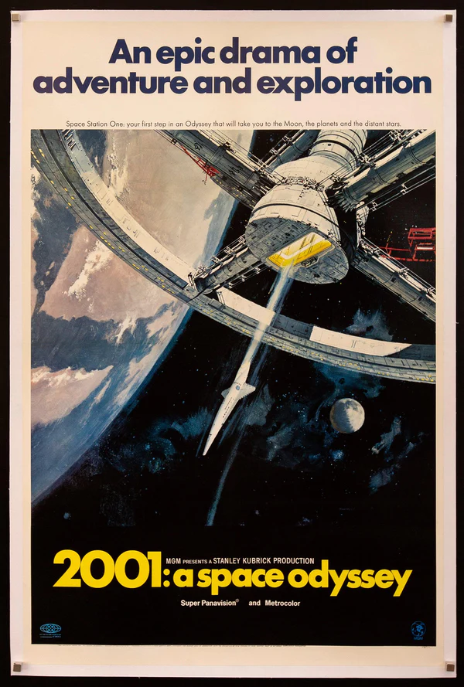
one example: Wikipedia
Open Google Chrome
Visit a page for a movie like 2001: A Space Odyssey
Right click and select the View page source option
Look at the HTML code that powers the site!
Notes:
Let’s take a look at an example. Has anyone been to Wikipedia before? We are going to visit a Wikipedia page, and take a look at the code that builds it. Can anyone name a movie?
Go to the Wikipedia page for a movie (or TV show, or music artist, or anything else), and follow the instructions on the slide. When viewing the source, explain that all the text is HTML code, and that the web browser (Google Chrome) interprets the code and makes it into a nice website. More info on the next slide.

Slide 14
HTML
HTML stands for HyperText Markup Language.
You can use HTML to build websites.
Web browsers (like Google Chrome) take an HTML document and turn it into a nice looking page.
Notes:
Does anyone know what HTML is? Click.
It stands for HyperText Markup Language. Click.
You can use it to build websites. Click.
As we saw, web browsers like Chrome take all that garbled mess of code and turn it into a nice looking website!

Slide 15
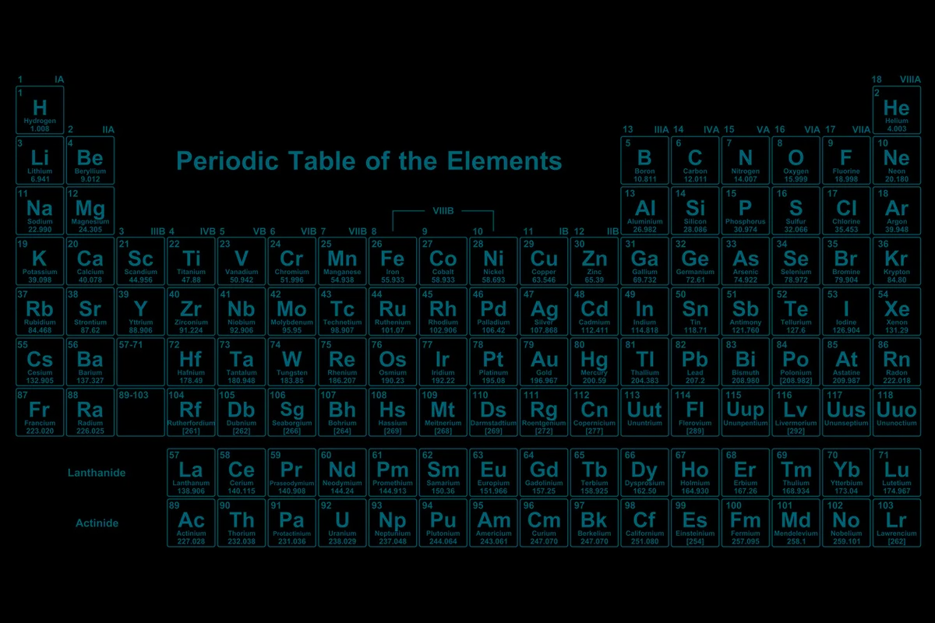
HTML Elements
what’s something you’ve seen on a website?
text
pictures
every little thing on a website is an element.
links
videos
Notes:
Now let’s talk a bit about HTML elements. Can anyone tell me something you’ve seen on a website before? Click.
Some examples are text, links, pictures, and videos. Click.
All of these things are examples of HTML elements. Elements are the building blocks of a website, and we will learn how to use some different ones to create different components on a site.

Slide 16
Our First HTML Element: A Header
<h1>Mel’s Website</h1>
< and >
Less-than and Greater-than signs
A.K.A.
Angle Brackets
Alligators
Pac Mans
<h1>
Opening tag for the element
A.K.A.
Tells HTML to start a big header element
Content
That which is to be enclosed within the HTML element
A.K.A.
The stuff inside the thing
</h1>
Closing tag for the element
A.K.A.
Tells HTML to end the big header element

Slide 17

CSS Style
CSS is a language that lets you customize styles.
it stands for Cascading Stylesheets.
you can change things like colors, fonts, and sizing.
if HTML is the body of a website, CSS is the clothing that it wears
Notes:
We are also going to use CSS to add style to our websites. Click.
CSS is a language that lets you customize styles. Click.
It stands for Cascading Stylesheets. Click.
You can change the appearance of almost anything on your website, including colors, fonts, and sizing. Click.
If HTML is the body of a website, CSS is kind of like the clothing it wears - it won’t change the actual content, but it can change how it is presented.

Slide 18
Code-Along Activity
it’s time to build your own website!
Notes:
Now let’s get coding! Where exactly will we be coding?

Slide 19
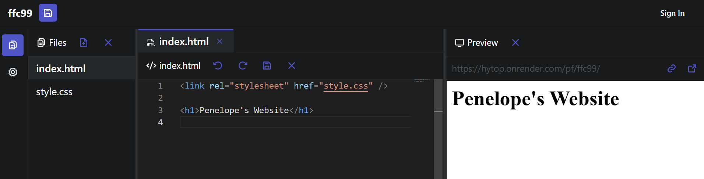
Save your Project
Pick a File
Write Code
See your Website
CHALLENGE: make it your website instead of Penelope’s!
Notes:
Now let’s do it! Click.
Go back to the lesson homepage. Click.
Under where it says “Code-Along” click the link! Click.
Make sure to open the preview pane. The preview should appear on the right. Click.
Now for your first task… try to change the name on the website so it reflects your name!
Continue the code-along following the guide.

Slide 20
Blooket
it’s time to see what you learned!
Notes:
End the session with the Blooket.

